Slide 1
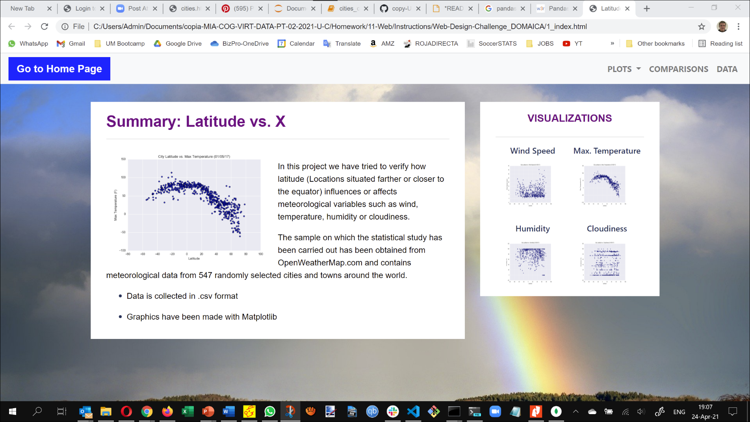
Landing page wide format

Slide 2
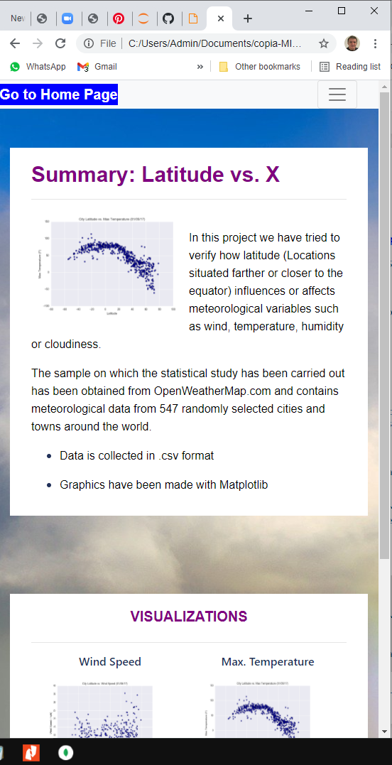
Landing page narrow format
Remarks
Drop down list reduced to icon with no text
Boxes vertically shown and scrolling activated

Slide 3
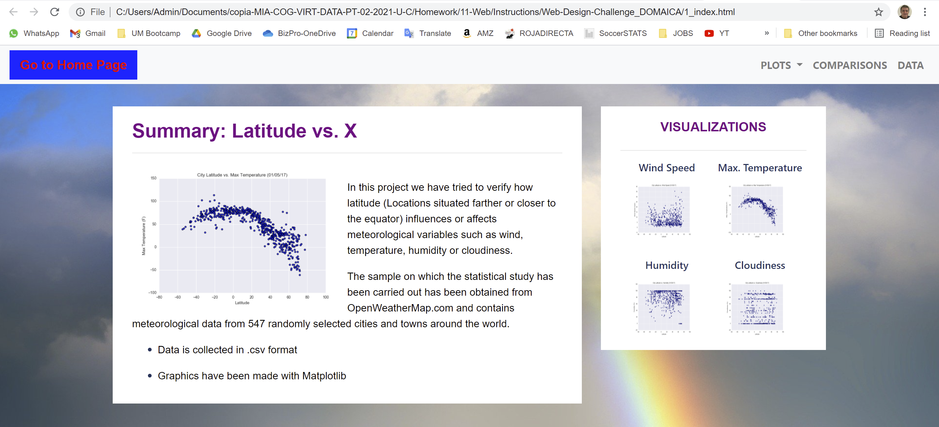
Landing page hover home button. Made a hover change of text color when position cursor over it

Slide 4
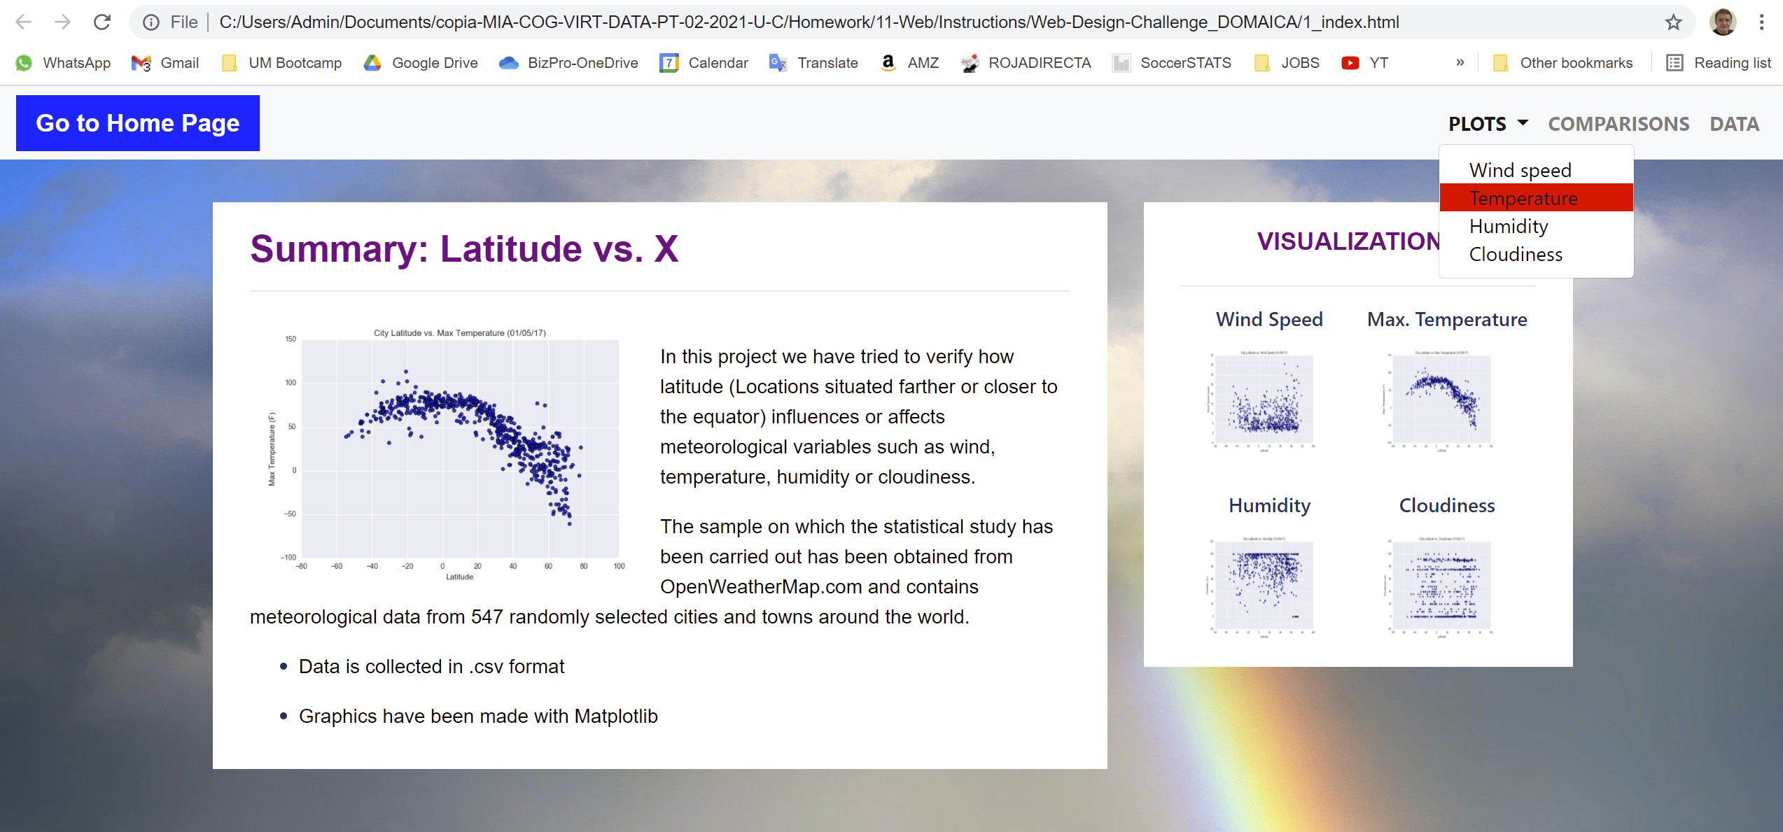
Landing page hover dropdown. Made a hover change of background color when position cursor over it

Slide 5
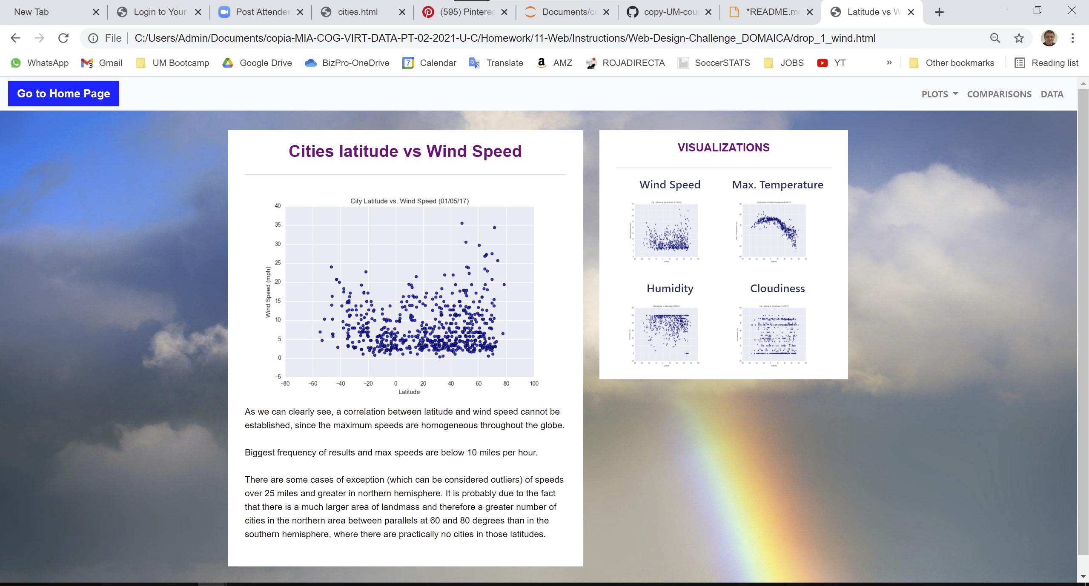
Latitude vs wind page wide format

Slide 6
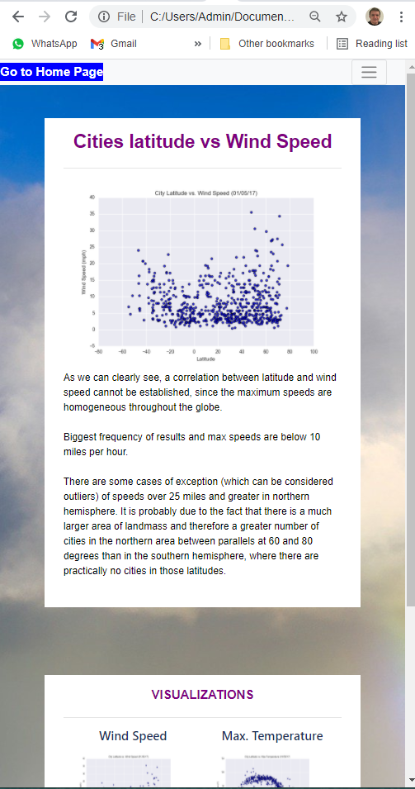
Latitude vs wind page narrow format
Same remarks as slide # 2 (vertical boxes, scrolling, dropdown menu)

Slide 7
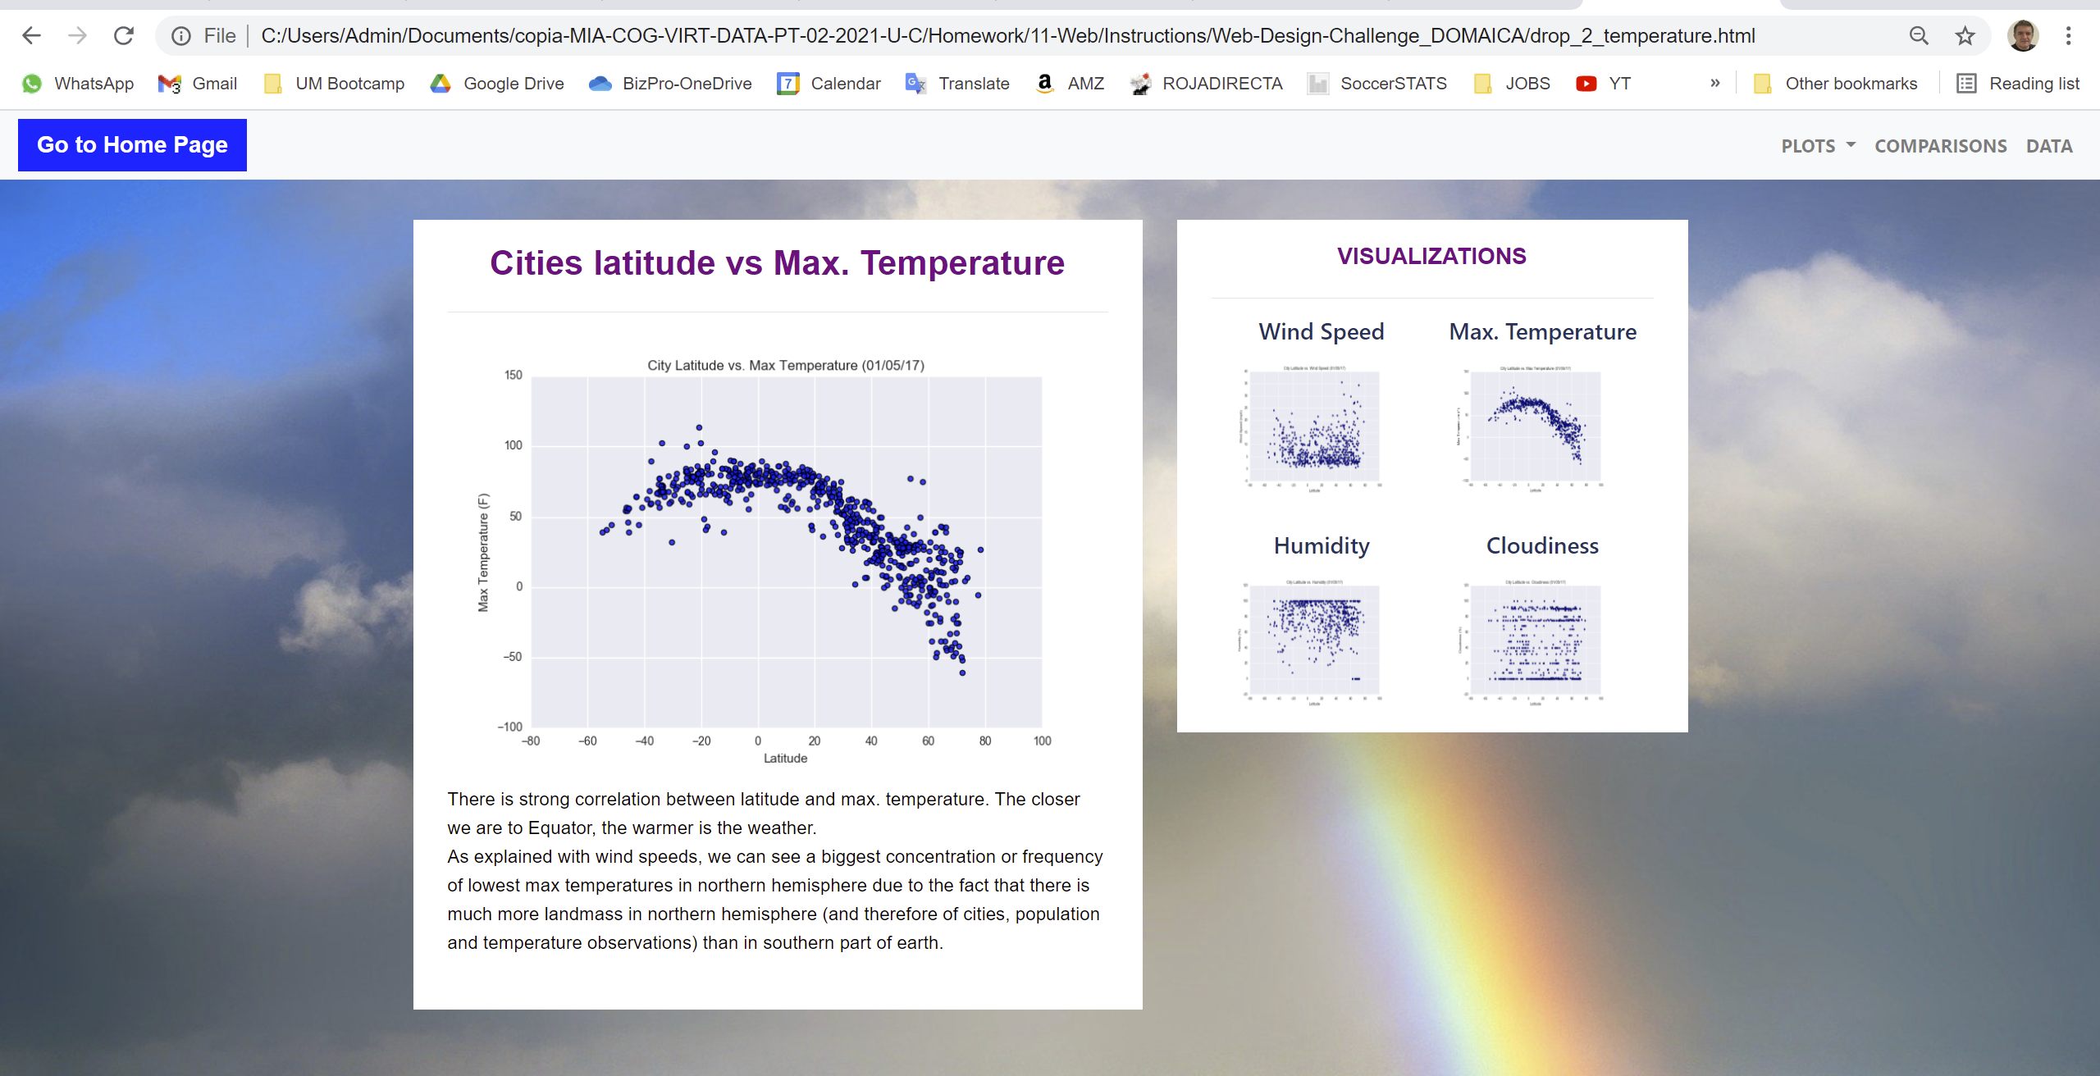
Latitude vs Max. Temperature page wide format

Slide 8
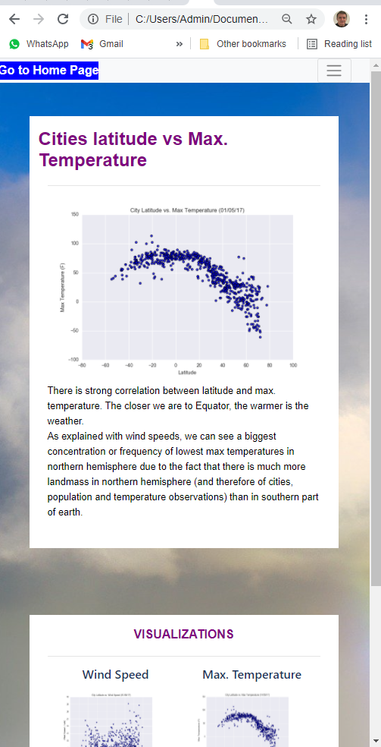
Latitude vs Max. Temperature page narrow format
Same remarks as slide # 2 (vertical boxes, scrolling, dropdown menu)

Slide 9
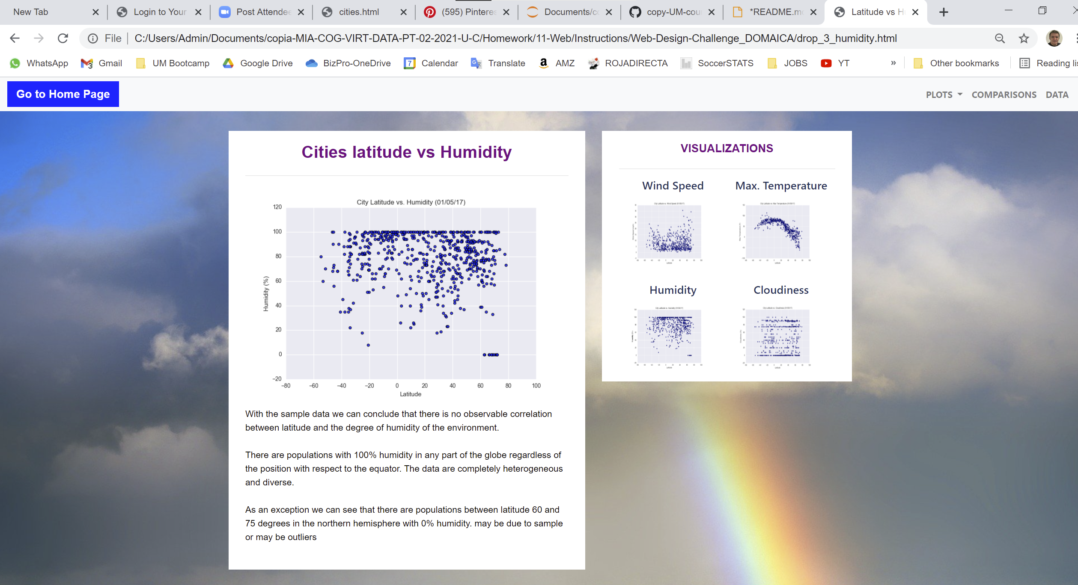
Latitude vs humidity page wide format

Slide 10
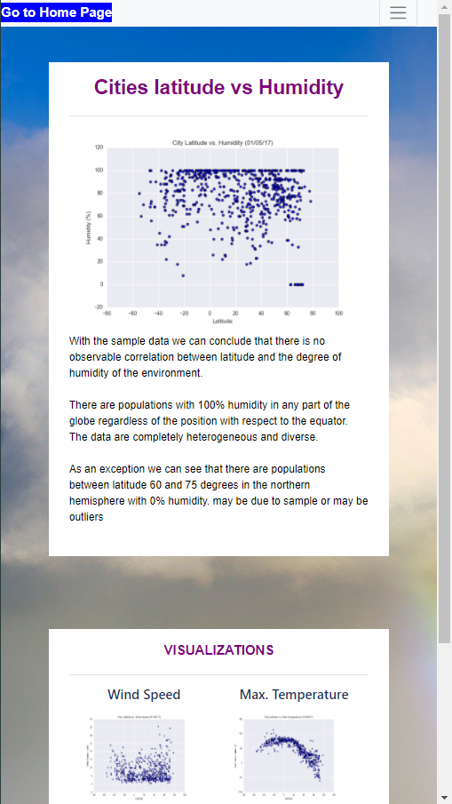
Latitude vs humidity page narrow format
Same remarks as slide # 2 (vertical boxes, scrolling, dropdown menu)

Slide 11
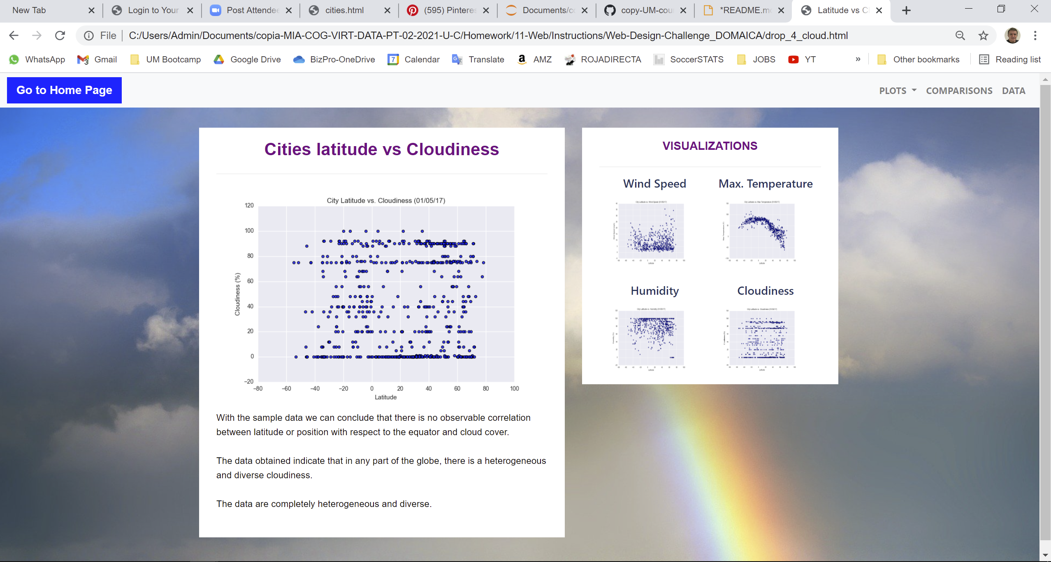
Latitude vs Cloudiness page wide format

Slide 12
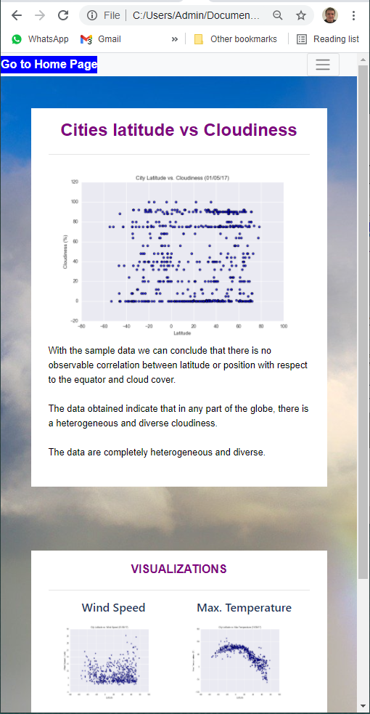
Latitude vs Cloudiness page narrow format
Same remarks as slide # 2 (vertical boxes, scrolling, dropdown menu)

Slide 13
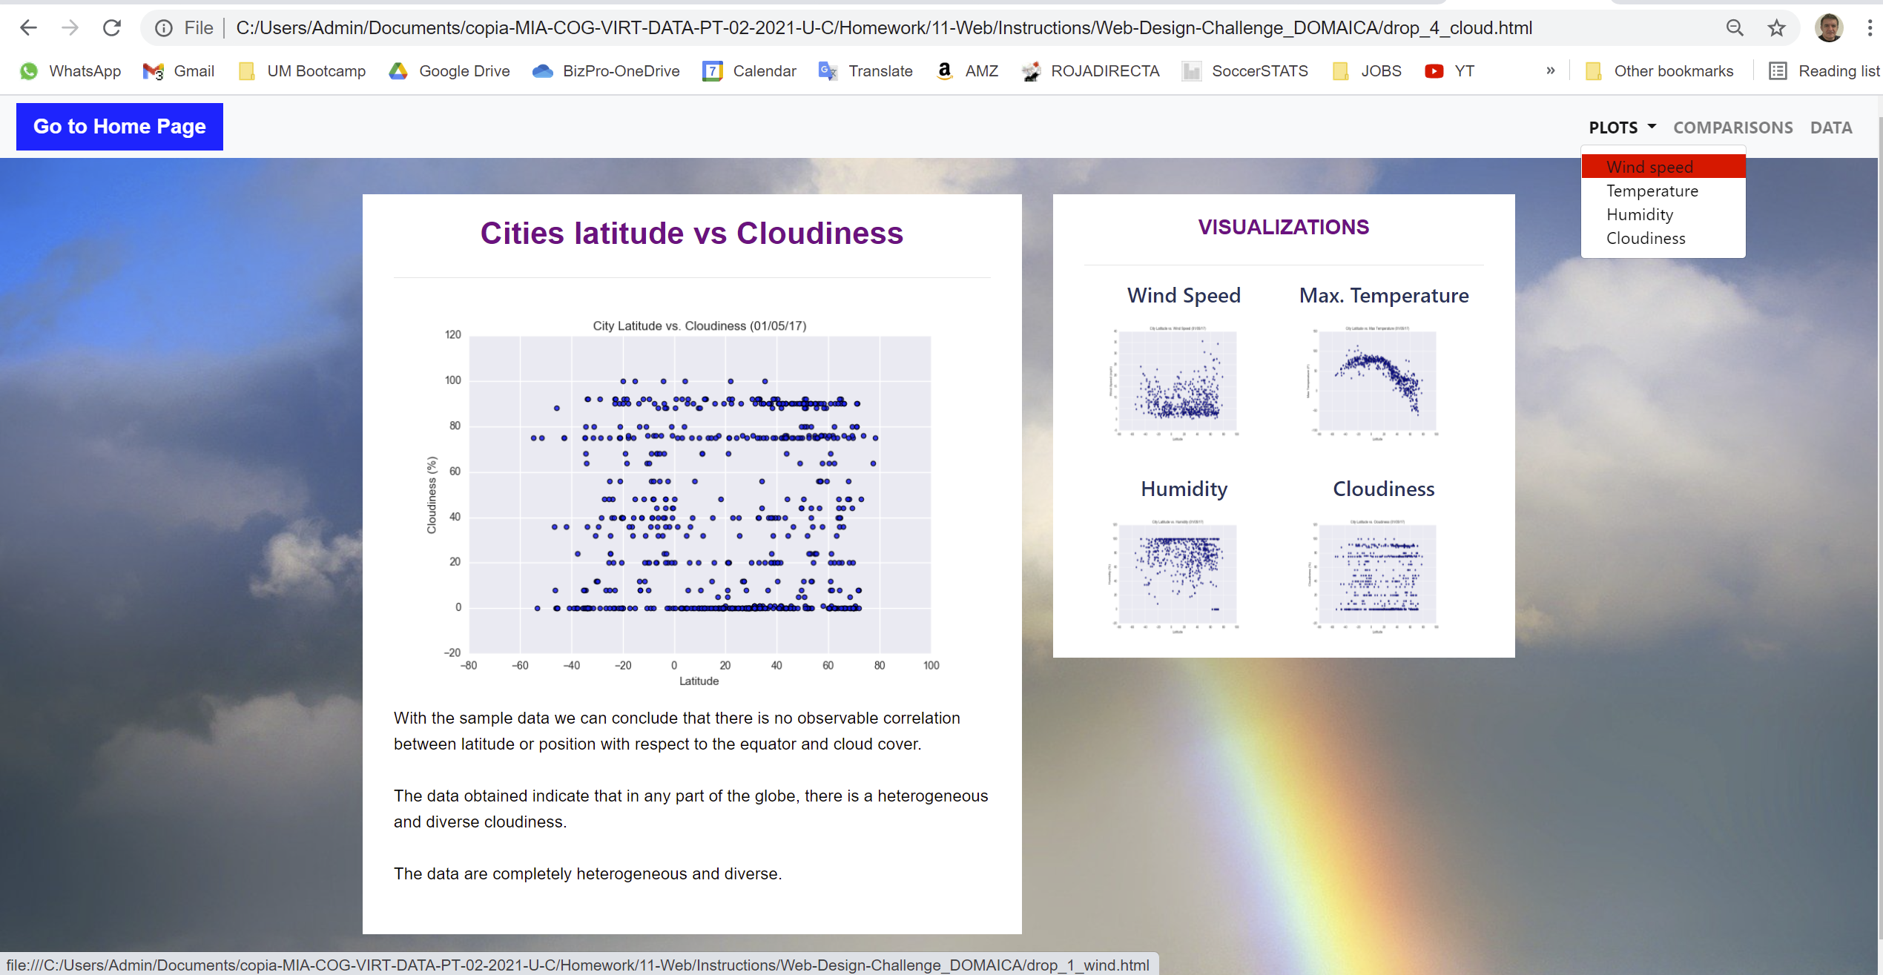
Example of dropdown menu wide format

Slide 14
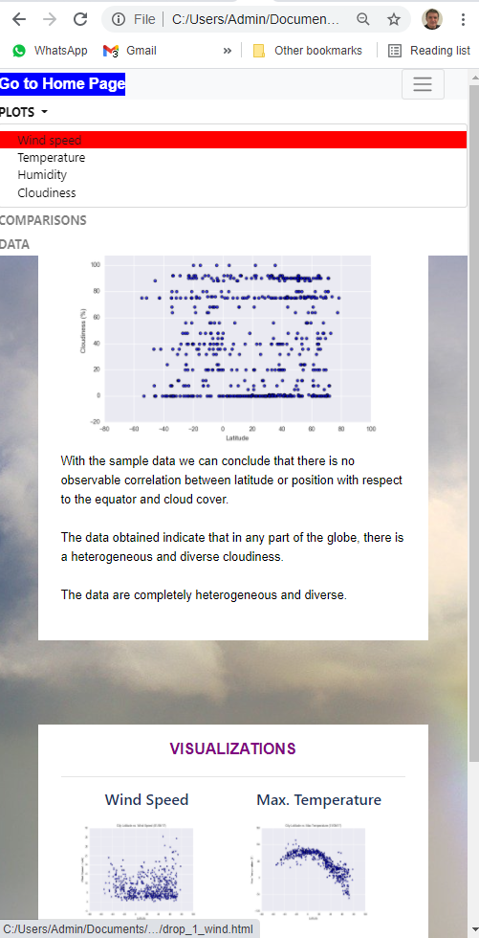
Example of dropdown menu narrow page format

Slide 15
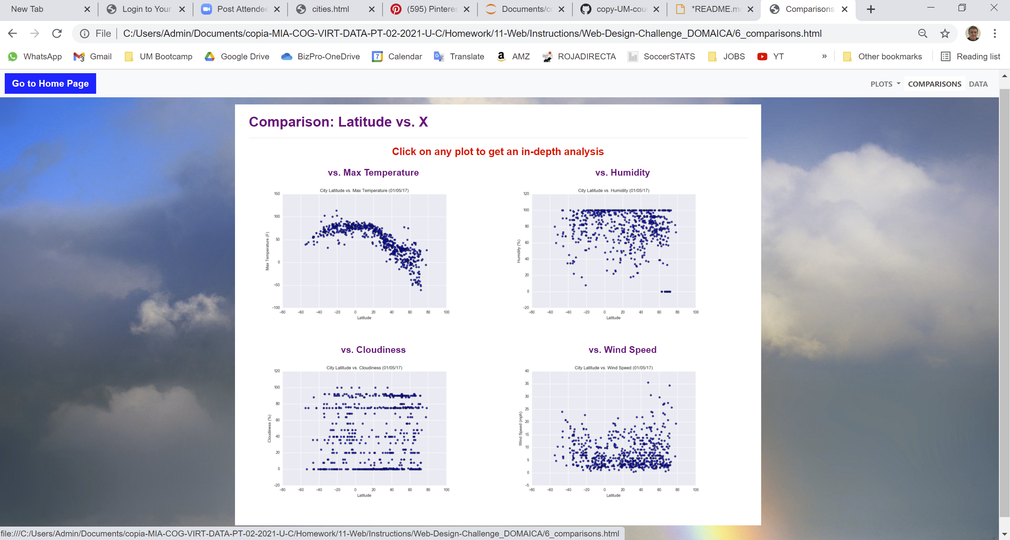
Comparisons page wide format

Slide 16
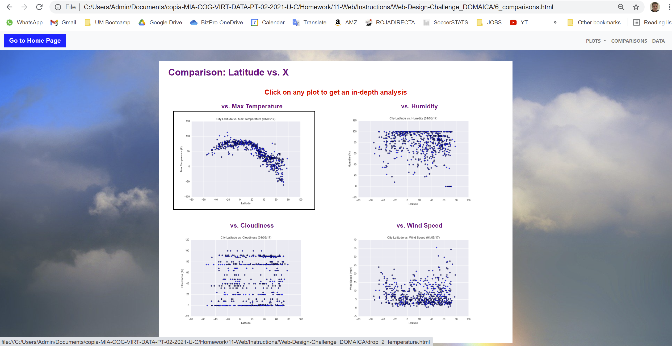
Comparisons page wide format. DETAIL HOVER OVER PLOT, Borders

Slide 17
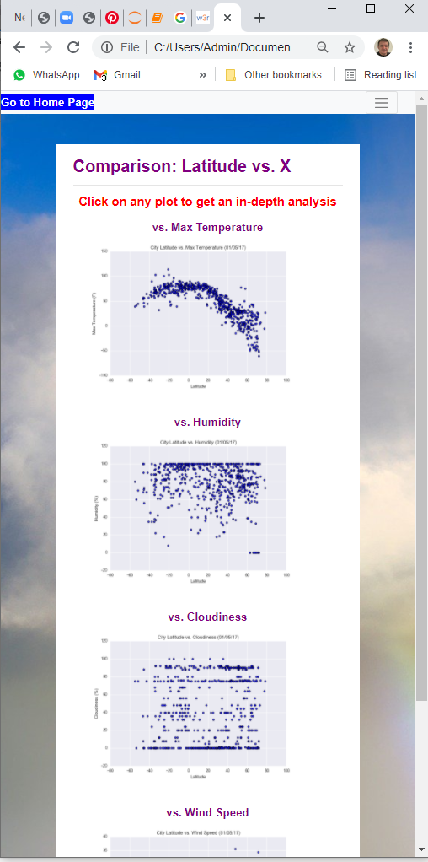
Comparisons page narrow format.
Check 4 boxes in vertical occupying the full wide row for this page width

Slide 18
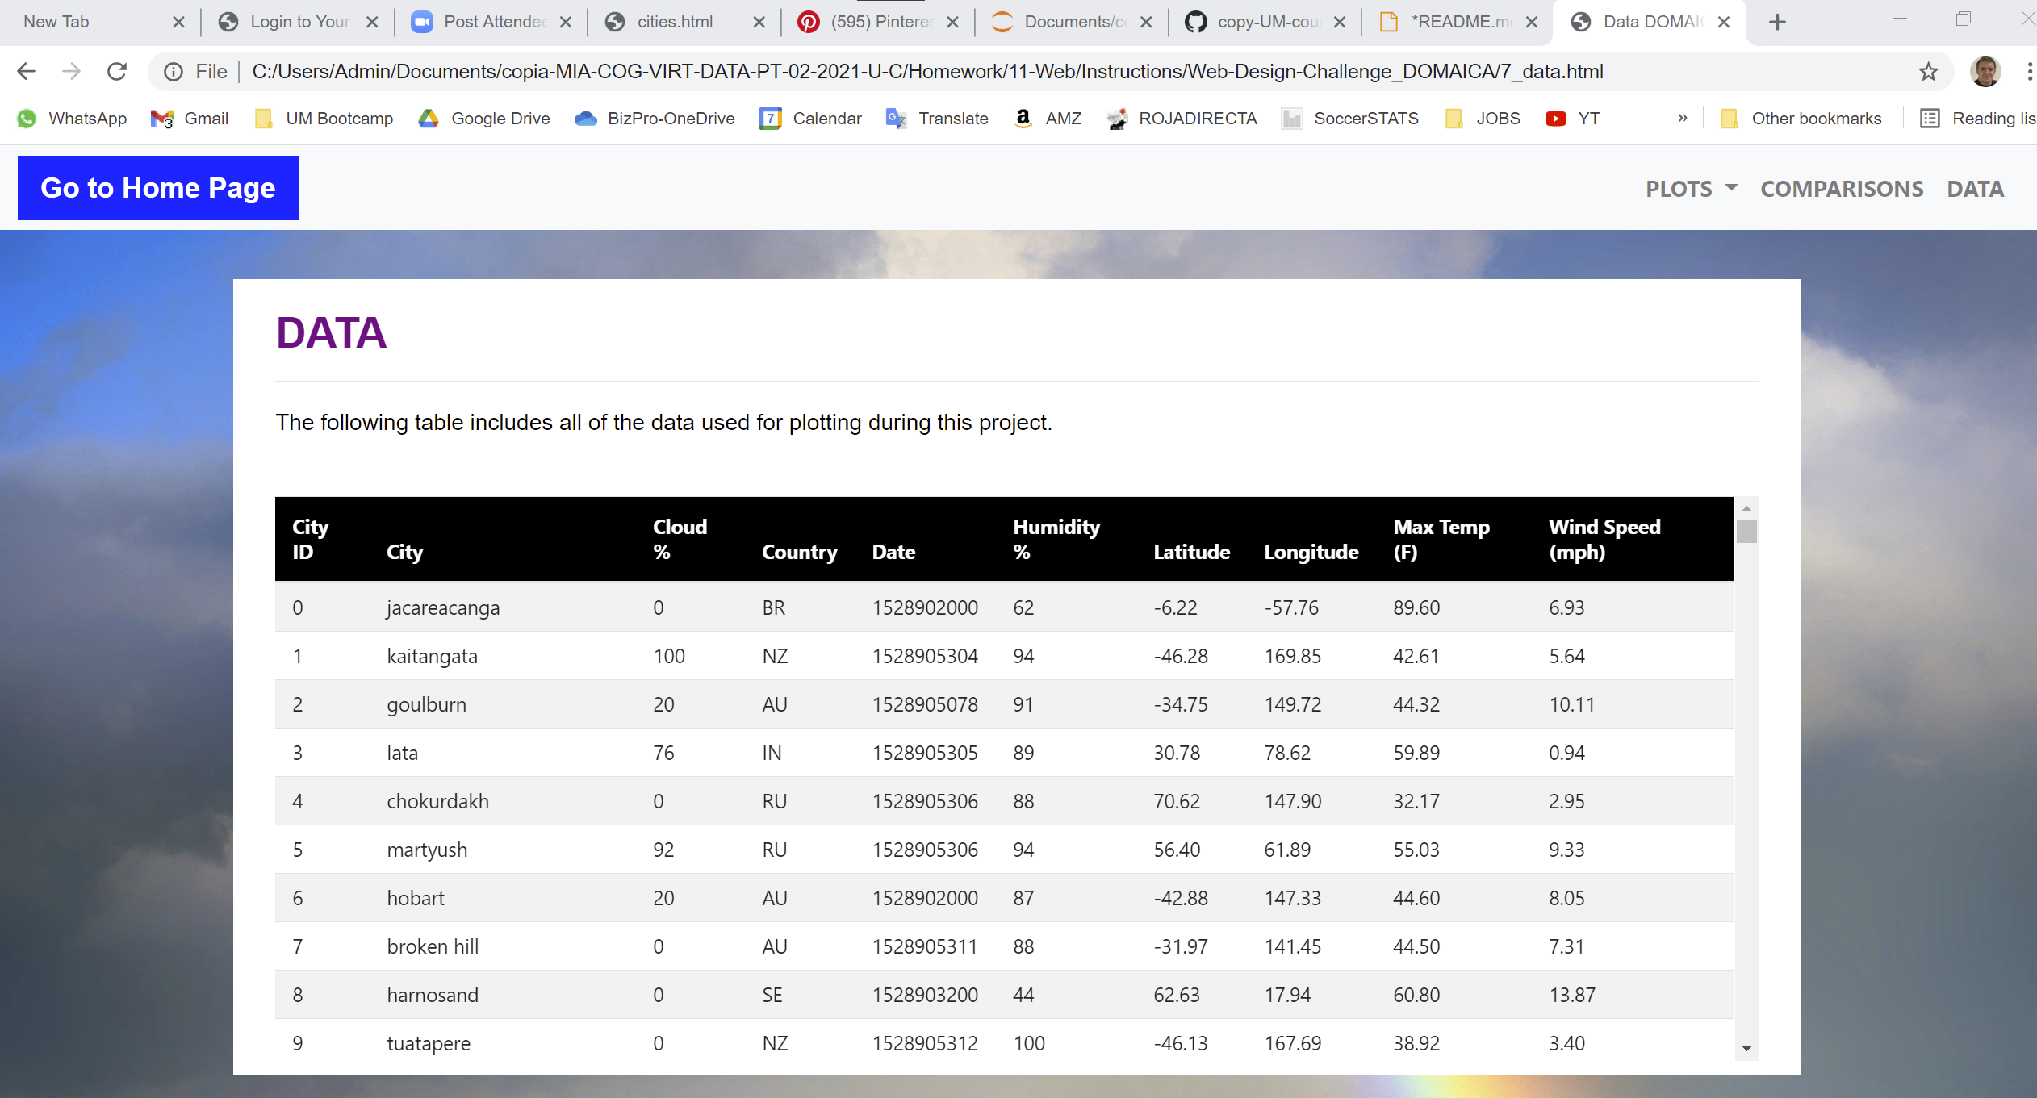
Data page wide format.
Setup title header row in top position fixed because it makes easier and more understandable to know columns content while scrolling

Slide 19
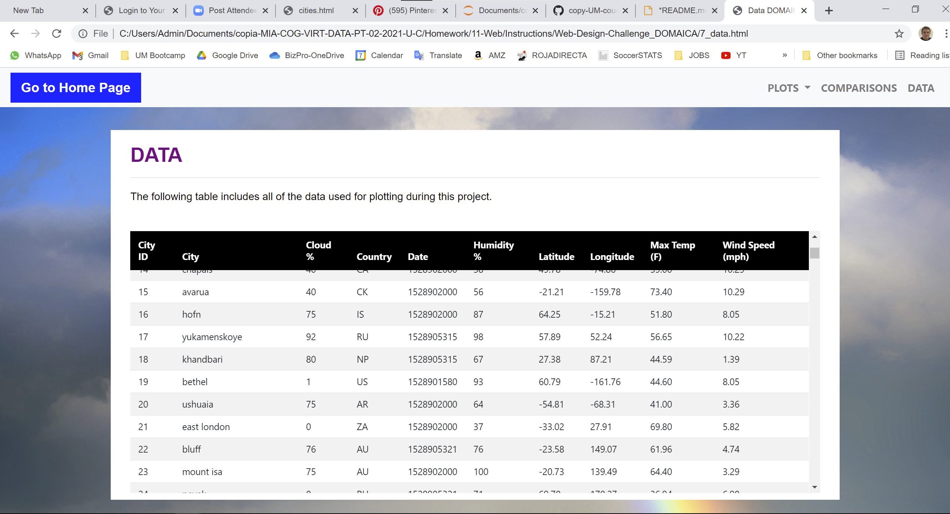
Data page wide format. SEE SCROLLING DETAIL AND TOP ROW ON TOP

Slide 20
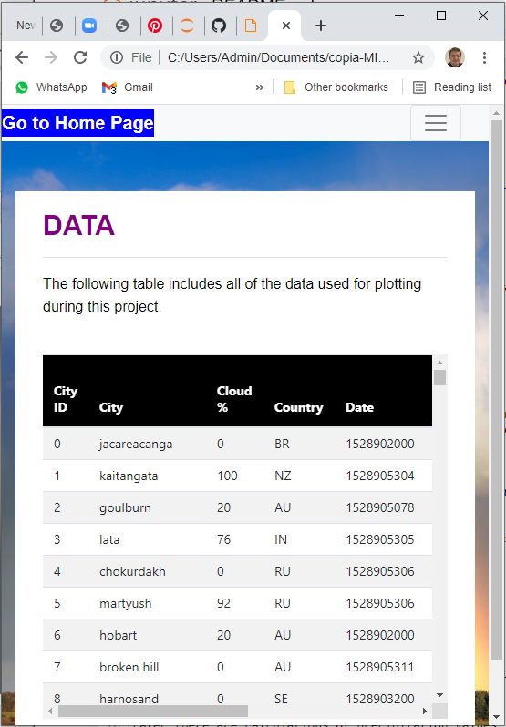
Data page narrow format.

